Slide 1
Data flow PRPGRAMS

Slide 2
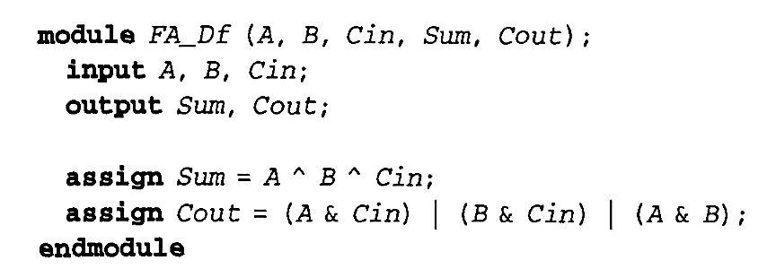
1-bit full-adder using the dataflow style
Sum = A XOR B XOR Cin
Cout = AB + B Cin + A Cin

Slide 3
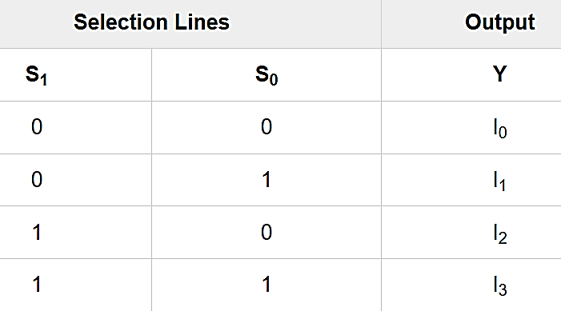

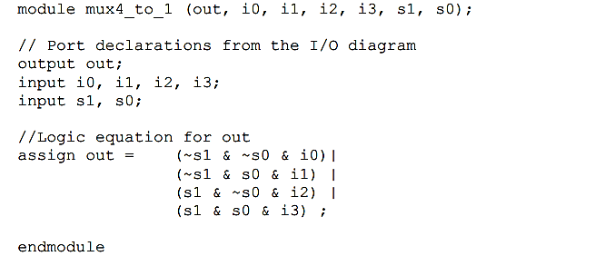
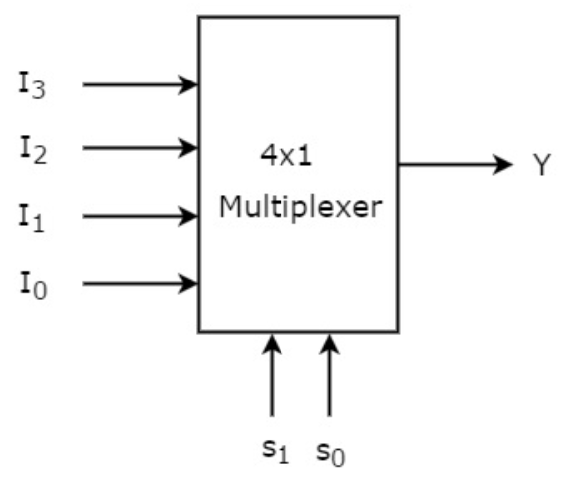
4:1 MUX in data flow

Slide 4
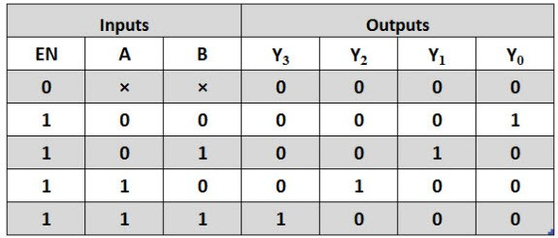
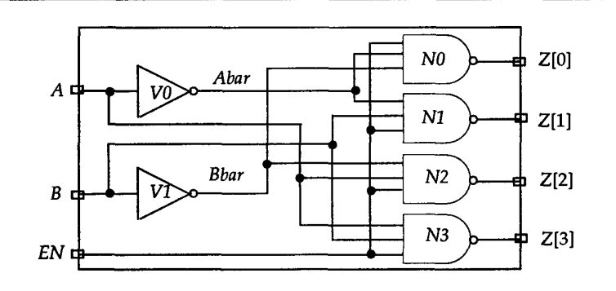
Q. 2-to-4 decoder in dataflow

Slide 5
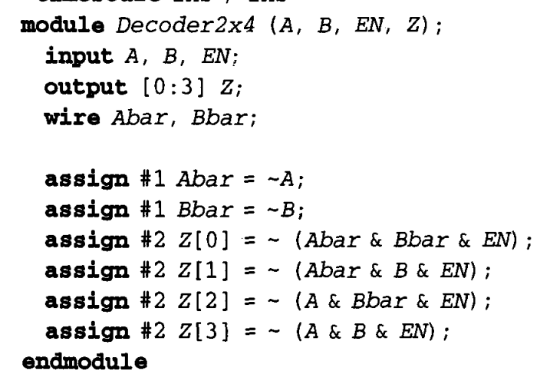

Slide 6
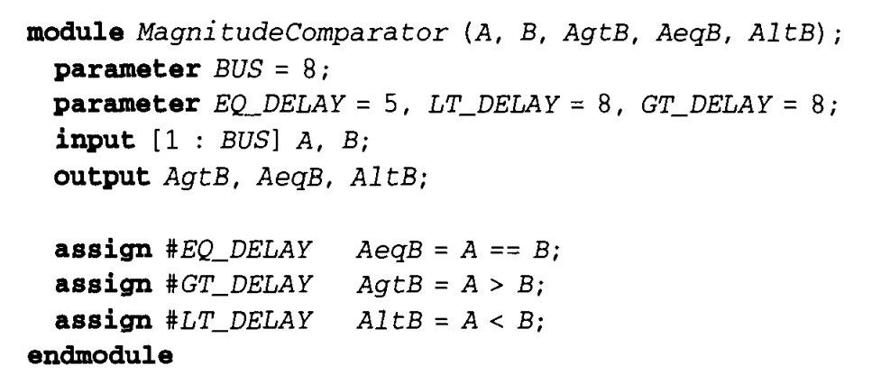
8 bit Magnitude Comparator

Slide 7
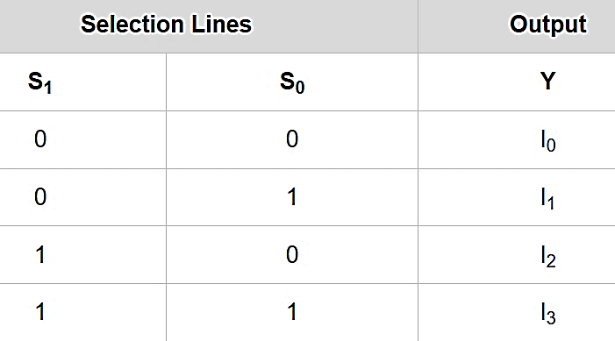
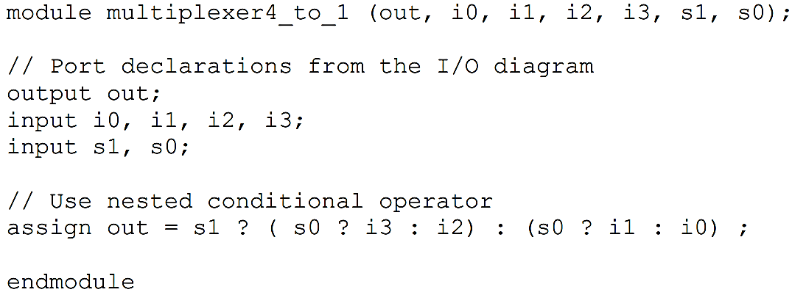
4-to-1 Multiplexer, Using Conditional Operators

Slide 8
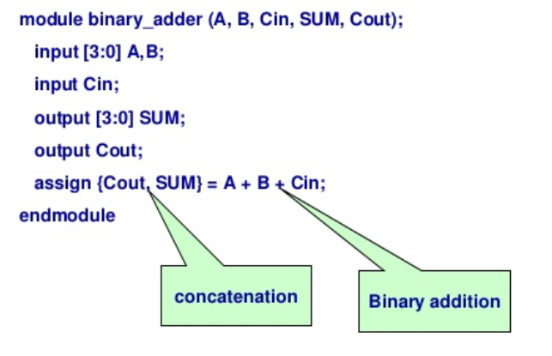
4 bit adder
1 CIN
1111 A
B
= COUT - - - - SUM

Slide 9
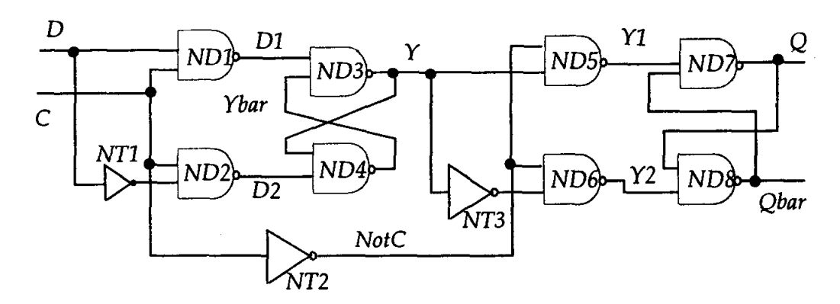
Master-slave Flip-flop

Slide 10
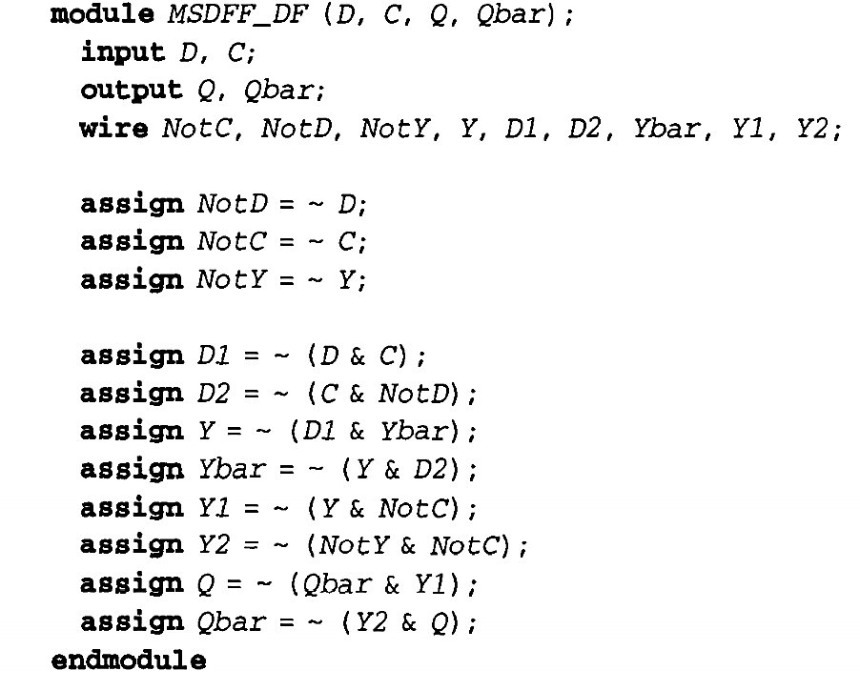

Slide 11
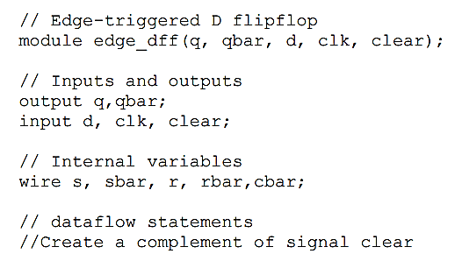
Verilog Code for Edge-Triggered D-flip flop
PTO

Slide 12
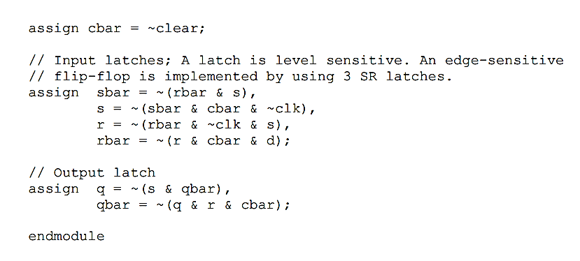

Slide 13
THANK YOU

